Slide 1

FIGURES FOR
CHAPTER 16
SEQUENTIAL CIRCUIT DESIGN
This chapter in the book includes:
Objectives
Study Guide
16.1 Summary of Design Procedure for Sequential Circuits
16.2 Design Example--Code Converter
16.3 Design of Iterative Circuits
16.4 Design of Sequential Circuits Using ROMs and PLAs
16.5 Sequential Circuit Design Using CPLDs
16.6 Sequential Circuit Design Using FPGAs
16.7 Simulation and Testing of Sequential Circuits
16.8 Overview of Computer-Aided Design
Design Problems
Additional Problems
Click the mouse to move to the next page.
Use the ESC key to exit this chapter.

Slide 2
Objectives
Design a sequential circuit using gates and flip-flops.
Test your circuit by simulating it and by implementing it in lab.
Design a unilateral iterative circuit. Explain the relationship
between iterative and sequential circuit, and convert from one to
the other.
4. Show how to implement a sequential circuit using a ROM or PLA
and flip-flops.
5. Explain the operation of CPLDs and FPGAs and show how they
can be used to implement sequential logic.

Slide 3
Summary of Design Procedure for Sequential Circuits
Given the problem Statement, determine the relationship between the input and output
sequences and derive state table. Construct a State Graph.
2. Reduce the table to a minimum number of states. Eliminate duplicates rows by row matching
and then form an implication table.
3. Use Flip/flops for representing states. Assign a unique combination of F/F states corresponds
to in each state in reduced table.
4. Form a transition table.
5. Plot next-state map and input maps for F/F and derive the input F/F equations.
6. Realize the F/F input equations and output equations using available logic
7. Testing your circuit

Slide 4
16.2 Design Example-Code Converter
BCD code → excess 3 code converter
X INPUT (BCD) |  |  |  | Z OUTPUT (excess-3)
t₃ | t₂ | t₁ | t₀ | t₃ | t₂ | t₁ | t₀
0 0 0 0 0 0 0 0 1 1 | 0 0 0 0 1 1 1 1 0 0 | 0 0 1 1 0 0 1 1 0 0 | 0 1 0 1 0 1 0 1 0 1 | 0 0 0 0 0 1 1 1 1 1 | 0 1 1 1 1 0 0 0 0 1 | 1 0 0 1 1 0 0 1 1 0 | 1 0 1 0 1 0 1 0 1 0
TABLE 16-1

Slide 5
16.2 Design Example-Code Converter
TABLE-16-2 State Table for Code Converter
TIME | INPUT Sequence Received (Least significant Bit First) | Present State | Next State X = 0 1 |  |  | Present Output(Z) X = 0 1
t₀ | reset | A |  | B | C |  | 1 | 0
t₁ | 0 1 | B C |  | D E | F G |  | 1 0 | 0 1
t₂ | 00 01 10 11 | D E F G |  | H I J K | L M N P |  | 0 1 1 1 | 1 0 0 0
t₃ | 000 001 010 011 100 101 110 111 | H I J K L M N P |  | A A A A A A A A | A A - - - - - - |  | 0 0 0 0 0 1 1 1 | 1 1 - - - - - -

Slide 6



16.2 Design Example-Code Converter
TABLE16-3 Reduced State Table for Code Converter
Time | Present State | Next State X = 0 1 |  |  | Present Output(Z) X = 0 1
t₀ | A |  | B | C |  | 1 | 0
t₁ | B C |  | D E | E E |  | 1 0 | 0 1
t₂ | D E |  | H H | H M |  | 0 1 | 1 0
t₃ | H M |  | A A | A - |  | 0 1 | 1 -
, and

Slide 7
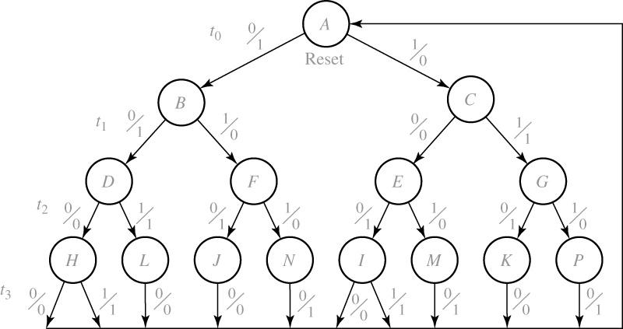
16.2 Design Example-Code Converter
Figure 16-1: State Graph for Code Converter

Slide 8
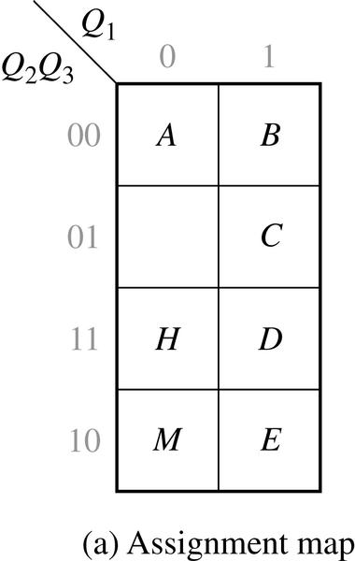


16.2 Design Example-Code Converter
Figure 16-2: Assignment Map for Flip Flops
 |  |  |  |  | Z
 |  | X=0 |  | X=1 | X=0 | X=1
A B C D E H M - | 000 100 101 111 110 011 010 001 | 100 111 110 011 011 000 000 xxx |  | 101 110 110 011 010 000 xxx xxx | 1 1 0 0 1 0 1 x | 0 0 1 1 0 1 x x
(b)transition table

Slide 9
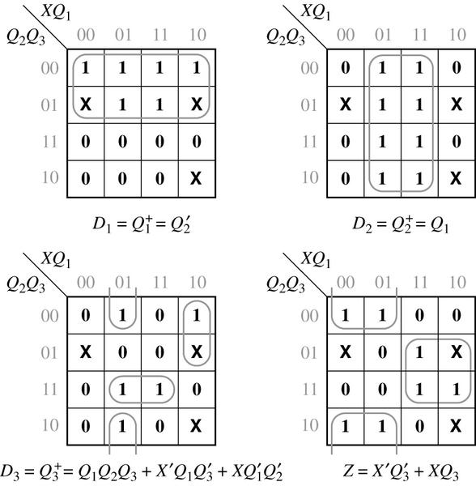
16.2 Design Example-Code Converter
Figure 16-3: Karnaugh Maps for Code Converter Design
After the state assignment has been made the transition table is filled in according to the assignment, and the next-state maps are plotted as shown in Figure 16-3

Slide 10
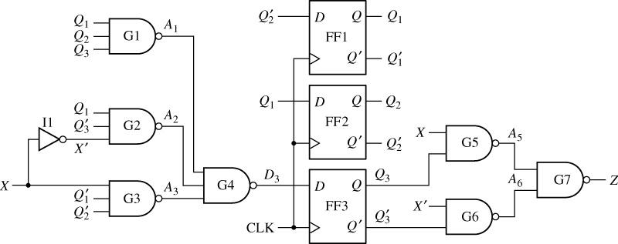
16.2 Design Example-Code Converter
Figure 16-4: Code Converter Circuit
Figure 16-4 shows the resulting sequential circuit

Slide 11
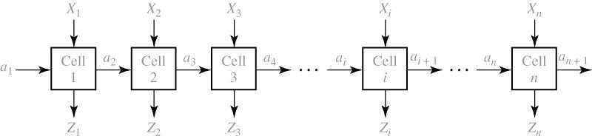
16.3 Design of Iterative Circuits
Sequential Circuit Design → Iterative Design
Figure 16-5: Unilateral Iterative Circuit
The simplest form of an iterative circuit consists of a linear array of combinational cells with signals between cells traveling in only one direction.

Slide 12
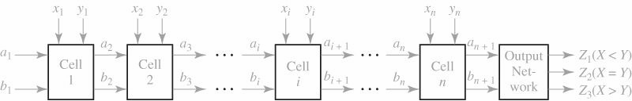
16.3 Design of Iterative Circuits
Comparator Design using Iterative Circuit
Figure 16-6: Form of Iterative Circuit for Comparing Binary Numbers
Figure 16-6 shows the form of the iterative circuit, although the number of leads between each pair of cells is not yet know.

Slide 13
16.3 Design of Iterative Circuits
TABLE 16-4 State Table for Comparator
S_{i} |  | S_{i+1} X_{i}Y_{i} = 00 01 11 10 |  |  |  |  | Z₁ Z₂ Z₃
X=Y X>Y X<Y | S₀ S₁ S₂ |  | S₀ S₁ S₂ | S₂ S₁ S₂ | S₀ S₁ S₂ | S₁ S₁ S₂ | 0 0 1 | 1 0 0 | 0 1 0

Slide 14
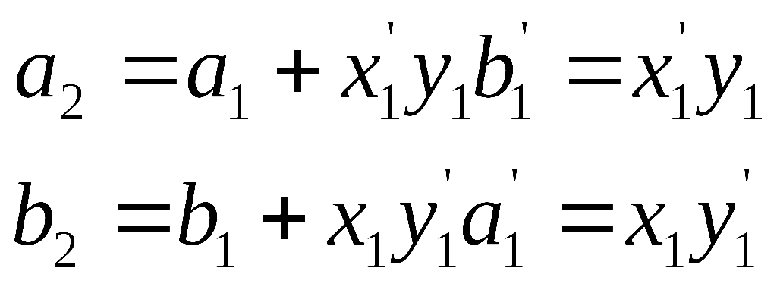
16.3 Design of Iterative Circuits
TABLE 16-5 State Assignment and Transition Table for Comparator
a_{i} | b_{i} | x_{i}y_{i}= | 00 | 01 | 11 | 10 | Z₁ | Z₂ | Z₃
0 0 1 | 0 1 0 |  | 00 01 10 | 10 01 10 | 00 01 10 | 01 01 10 | 0 0 1 | 1 0 0 | 0 1 0
Equations for the first cell (a1=b1=’00’)

Slide 15
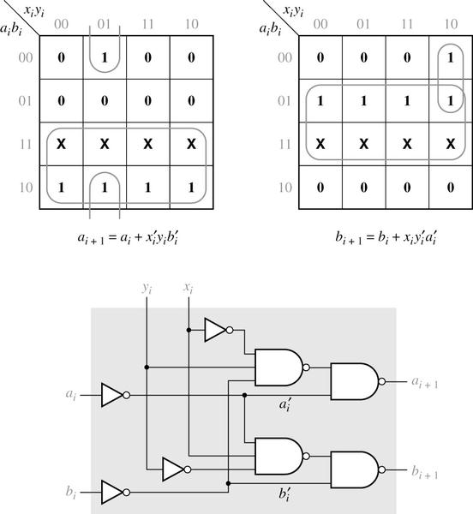
16.3 Design of Iterative Circuits
Figure 16-7:Typical Cell for Comparator

Slide 16
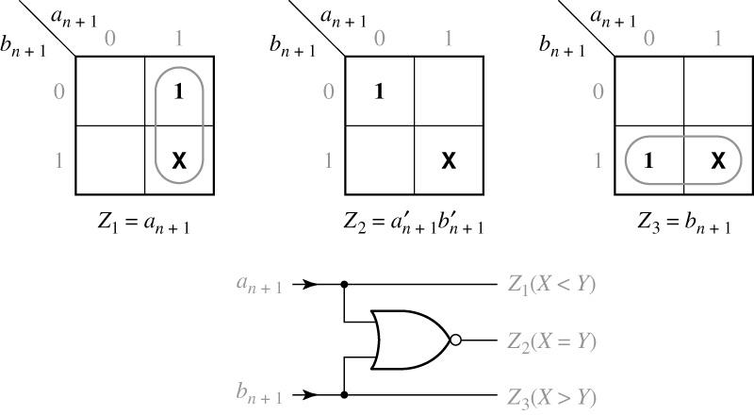
16.3 Design of Iterative Circuits
Figure 16-8: Output Circuit for Comparator
output maps, equations, and circuit.
Z₁ =1 if X < Y , Z₂=1 if X = Y , Z₃=1 if X > Y

Slide 17
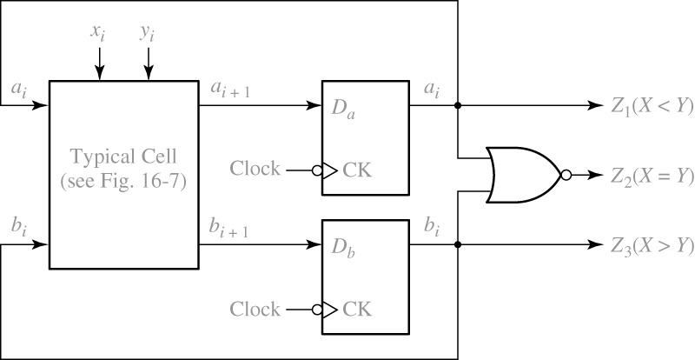
16.3 Design of Iterative Circuits
Figure 16-9: Sequential Comparator for Binary Numbers
Figure 16-9 shows the resulting circuit.

Slide 18
16.4 Design of Sequential Circuits Using ROMs and PLAs
Sequential Circuit can be designed using a ROM and F/F’s
TABLE 16-6: Revisit the Code Converter Design
(a)State table
Present State | Next State |  |  | Present Output (Z)
 | X= | 0 | 1 | X= | 0 | 1
A |  | B | C |  | 1 | 0
B C |  | D E | E E |  | 1 0 | 0 1
D E |  | H H | H M |  | 0 1 | 1 0
H M |  | A A | A - |  | 0 1 | 1 -

Slide 19
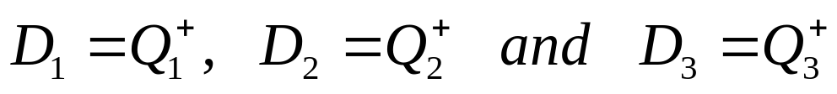
16.4 Design of Sequential Circuits Using ROMs and PLAs
TABLE 16-6
(b)Transition table
 |  |  |  |  |  | Z
 | Q₁ | Q₂ | Q₃ | X=0 | X=1 | X=0 | X=1
A B C D E H K | 0 0 0 0 1 1 1 | 0 0 1 1 0 0 1 | 0 1 0 1 0 1 0 | 001 011 100 101 101 000 000 | 010 100 100 101 110 000 - | 1 1 0 0 1 0 1 | 0 0 1 1 0 1 -
Q
+
Q
+
Q
+
1
2
3

Slide 20
16.4 Design of Sequential Circuits Using ROMs and PLAs
TABLE 16-6
X | Q₁ | Q₂ | Q₃ | Z | D₁ | D₂ | D₃
0 0 0 0 0 0 0 0 1 1 1 1 1 1 1 1 | 0 0 0 0 1 1 1 1 0 0 0 0 1 1 1 1 | 0 0 1 1 0 0 1 1 0 0 1 1 0 0 1 1 | 0 1 0 1 0 1 0 1 0 1 0 1 0 1 0 1 | 1 1 0 0 1 0 1 x 0 0 1 1 0 1 x x | 0 0 1 1 1 0 0 x 0 1 1 1 1 0 x x | 0 1 0 0 0 0 0 x 1 0 0 0 1 0 x x | 1 1 0 1 1 0 0 x 0 0 0 1 0 0 x x
(c)Truth table
*ROM INPUTS
(X,Q₁,Q₃ and Q₃)
*ROM OUTPUTS (Z,D₁,D₂ and D₃)

Slide 21
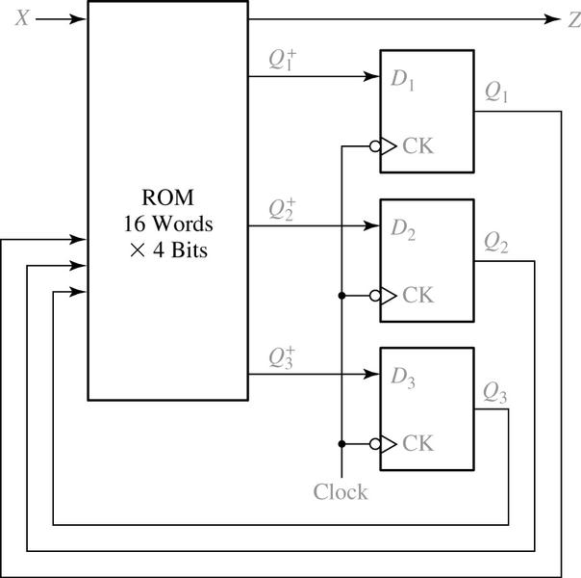
16.4 Design of Sequential Circuits Using ROMs and PLAs
Figure 16-10:Realization of Table 16.6(a) Using a ROM
A ROM with four input(2⁴ words) and four outputs is required, as shown in Figure16-10

Slide 22
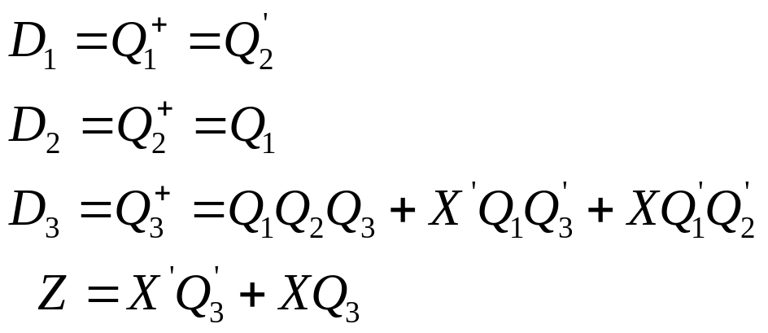
16.4 Design of Sequential Circuits Using ROMs and PLAs
TABLE 16-7
X | Q₁ | Q₂ | Q3 | Z | D₁ | D₂ | D₃
- - - 0 1 0 1 | - 1 1 1 0 - - | 0 - 1 - 0 - - | - - 1 0 - 0 1 | 0 0 0 0 0 1 1 | 1 0 0 0 0 0 0 | 0 1 0 0 0 0 0 | 0 0 1 1 1 0 0

Slide 23
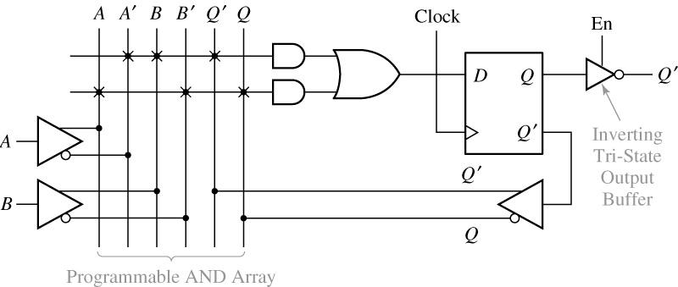

16.4 Design of Sequential Circuits Using ROMs and PLAs
Figure 16-11: Segment of Sequential PAL

Slide 24
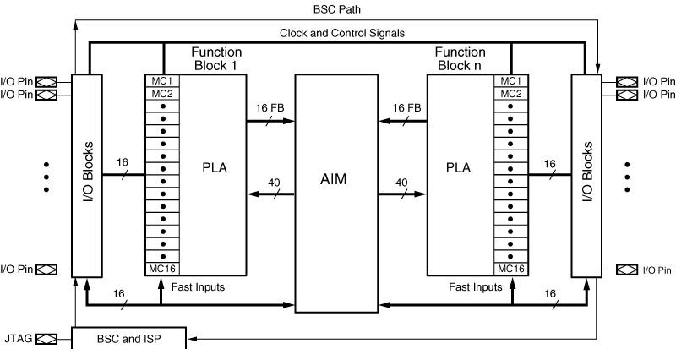
16.5 Sequential Circuit Design Using CPLDs
Figure 16-12: CoolRunner-II Architecture(Figure based on figures and text owned by Xilinx, Inc., Courtesy of Xilinx, Inc. © Xilinx, Inc. 1999-2003. All rights reserved.)
Figure 16-12 shows the structure of a Xilinx CoolRunner II CPLD, which uses a PLA in each function block.

Slide 25
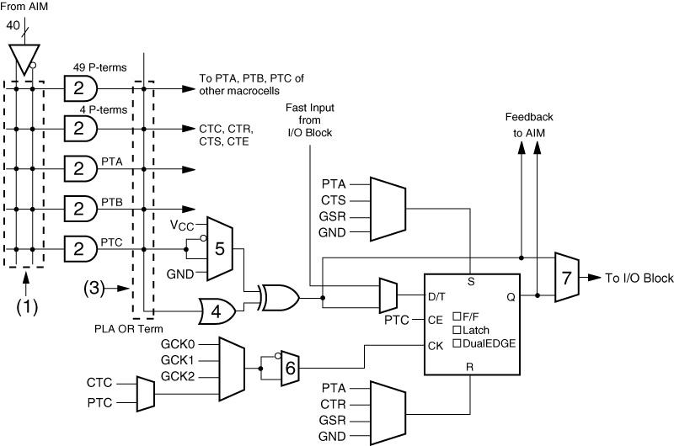
16.5 Sequential Circuit Design Using CPLDs
Figure 16-13: CoolRunner-II Macrocell(Figure based on figures and text owned by Xilinx, Inc., Courtesy of Xilinx, Inc. © Xilinx, Inc. 1999-2003. All rights reserved.)
Figure 16-13 represents a CoolRunner-II macrocell and the associated AND array.

Slide 26
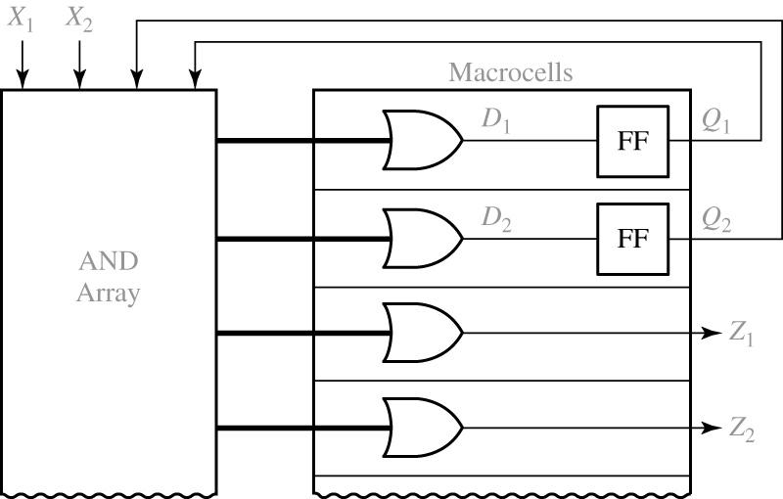
16.5 Sequential Circuit Design Using CPLDs
Figure 16-14: CPLD Implementation of a Mealy Machine
Figure 16-14 shows how a Mealy sequential machine with two input, two outputs, and two flip-flops can be implemented by a CPLD

Slide 27
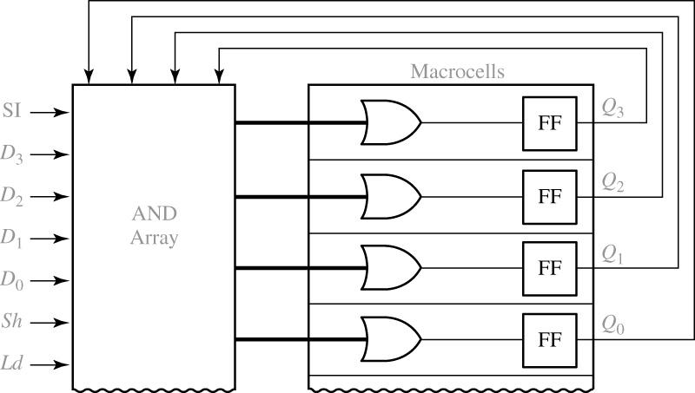
16.5 Sequential Circuit Design Using CPLDs
Figure 16-15: CPLD Implementation of a Shift Register
Figure 16-15 shows how the 4-bit loadable right-shift register of Figure 12-15 can be implemented using four macrocells of a CPLD

Slide 28
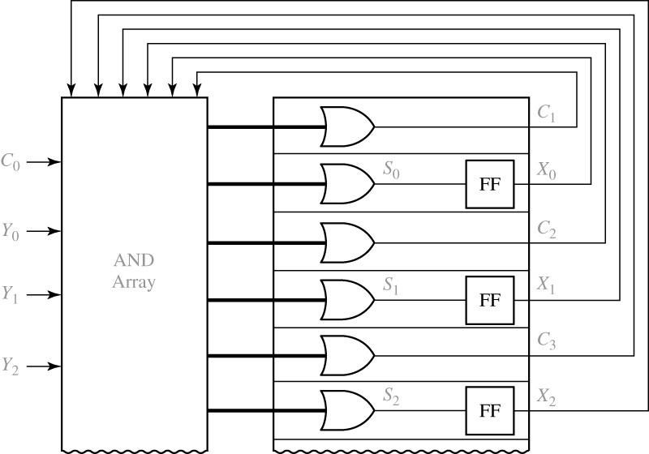
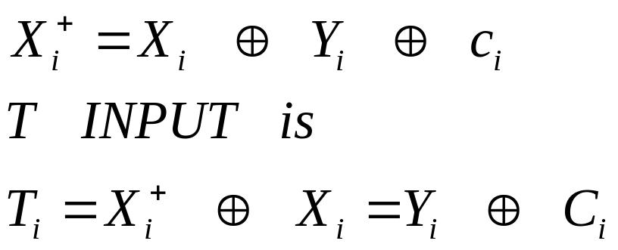
16.5 Sequential Circuit Design Using CPLDs
Figure 16-16: CPLD Implementation of a Parallel Adder with Accumulator
Figure 16-16 shows how three bit of the parallel adder with accumulator of Figure 12-5 can be implemented using a CPLD.

Slide 29
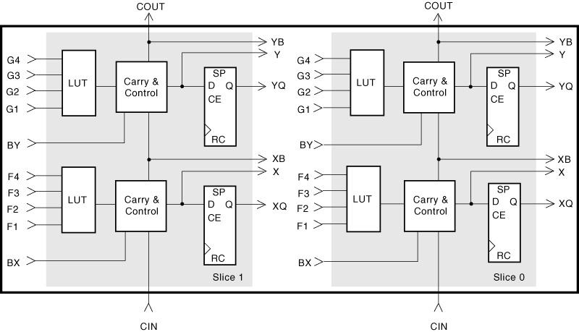
16.6 Sequential Circuit Design Using FPGAs
Figure 16-17: Xilinx Virtex/Spartan II CLB (Figure based on figures and text owned by Xilinx, Inc., Courtesy of Xilinx, Inc. © Xilinx, Inc.1999-2003. All rights reserved.)

Slide 30
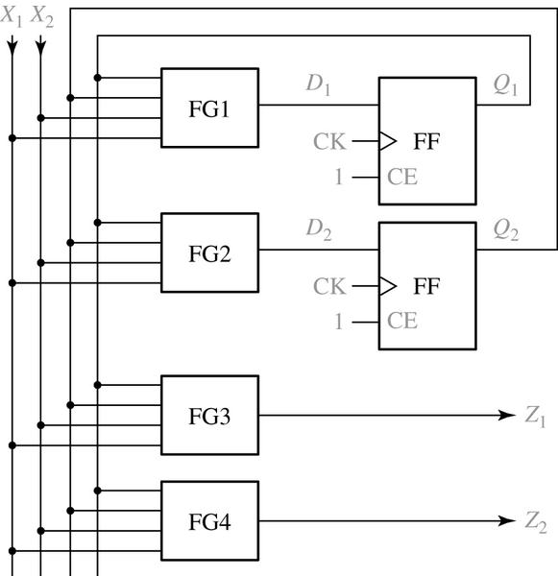
16.6 Sequential Circuit Design Using FPGAs
Figure 16-18: FPGA Implementation of a Mealy Machine
Figure 16-18 shows how a Mealy sequential machine with two inputs, two output, and two flip-flops can be implemented by a FPGA.

Slide 31
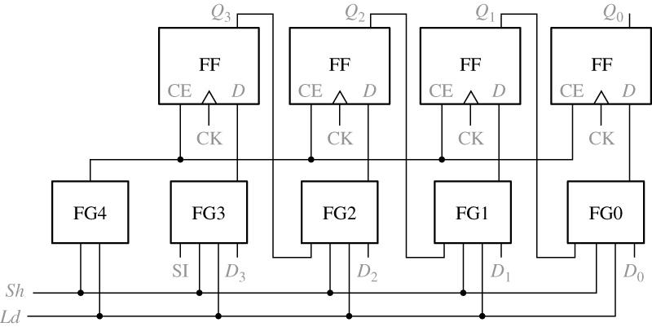
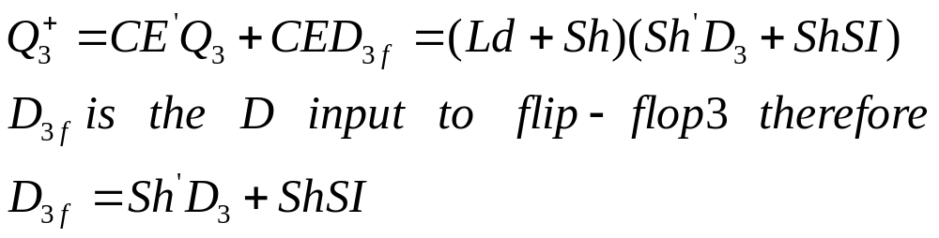
16.6 Sequential Circuit Design Using FPGAs
Figure 16-19: FPGA Implementation of a Shift Register
*Figure 16-19 shows how the 4-bit loadable right-shift register Figure 12-15 can be implemented using an FPGA.

Slide 32
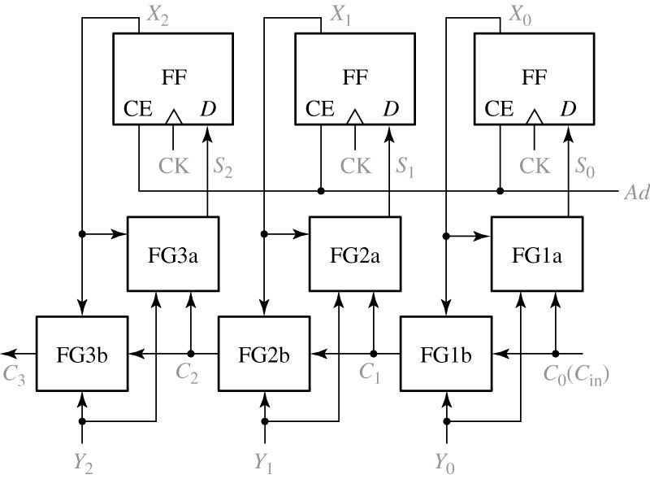
16.6 Sequential Circuit Design Using FPGAs
Figure 16-20: FPGA Implementation of a Parallel Adder with Accumulator
Figure 16-20 shows how three bits of the parallel adder with accumulator of Figure 12-5 can be implemented using an FPGA

Slide 33
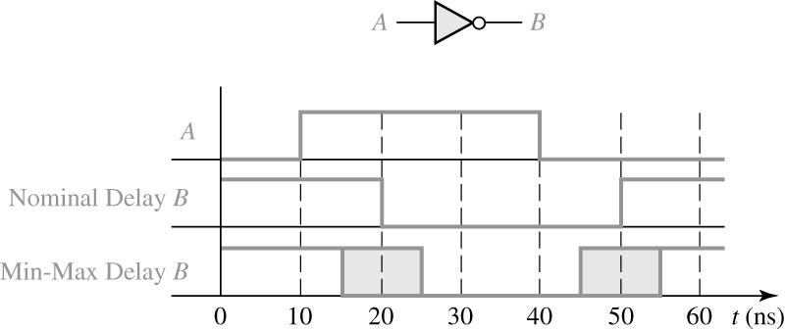
16.7 Simulation and Testing of Sequential Circuits
Figure 16-21: Simulator Output for an Inverter
Figure 16-21 shows the output from an inverter which has a nominal delay of 10 ns, a minimum delay of 5 ns, and a maximum delay of 15 ns.

Slide 34
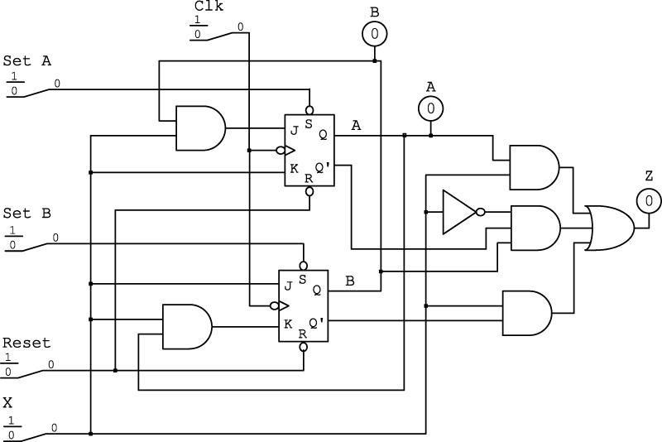
16.7 Simulation and Testing of Sequential Circuits
Figure 16-22: Simulation Screen for Figure 13-7
Figure 16-22 shows a simulator screen for testing the Mealy sequential circuit of Figure 13-7.

Slide 35
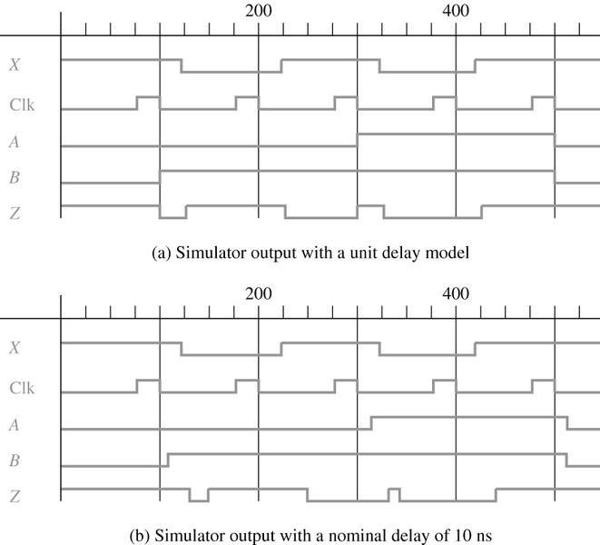
16.7 Simulation and Testing of Sequential Circuits
Figure 16-23
Figure 16-23 shows the simulator input waveform for the example of Figure 16-22,using the test sequence X=10101.

Slide 36
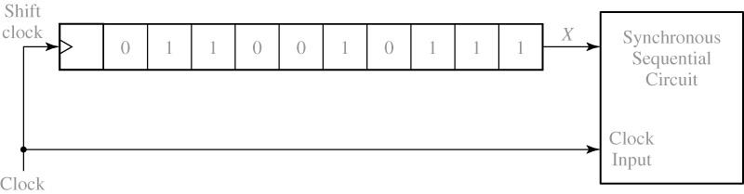
16.7 Simulation and Testing of Sequential Circuits
Figure 16-24: Using a Shift Register to Generate Synchronized Inputs
The former can be accomplished by loading the inputs into a shift register, and then using the circuit clock to shift them into the circuit one at a time, as shown in figure 16-24.

Slide 37
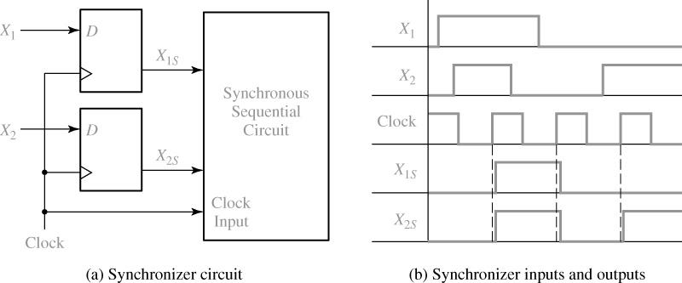
16.7 Simulation and Testing of Sequential Circuits
Figure 16-25

Slide 38
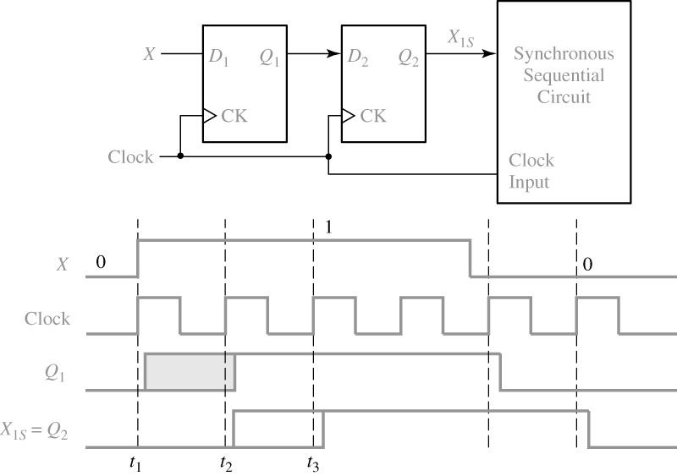
16.7 Simulation and Testing of Sequential Circuits
Figure 16-26: Synchronizer with Two D Flip-Flops
Figure 16-26 shows a more reliable synchronizer that uses two D flip-flop to synchronize a single asynchronous input,X

Slide 39
16.7 Overview of Computer-Aided Design
Functions performance of CAD tools
Generation and Minimization of logic equation
Generation of bit patterns for programming PLD’s
Schematic Capture
Simulation
Synthesis tools
IC design and Layout
Test Generation
PC board Layout

Slide 40
16.7 Simulation and Testing of Sequential Circuits
Design a small digital systems with an FPGA
Draw a block diagram of the digital system. Define the required control signals and construct state graph and describes the required sequence of operations
Workout a detailed logic design using gates, F/F,register, counter,adders, etc… (HDL)
Construct a logic diagram using a schematic capture program(HDL)
Simulate and debug the logic diagram and make any necessary corrections to the design(HDL)
Run an implementation program that fits the design into the target FPGA
Simulation and verifying
Download the bit pattern into FPGA and test.

